Slide 1
brief introduction to Artificial Intelligence
Created By: Abdus Salam Azad
Modified By: Md. Ashraful Islam & Kowshic Roy

Slide 2


Introduction to Artificial Intelligence
Instructors:
1. Kowshic Roy
Lecturer
Dept. of CSE, BUET
Email: kowshic@cse.buet.ac.bd
Mobile no.: 01521249494
2. Md. Emamul Haque Pranta
Lecturer
Dept. of CSE, BUET
Email: pranta@teacher.cse.buet.ac.bd

Slide 3
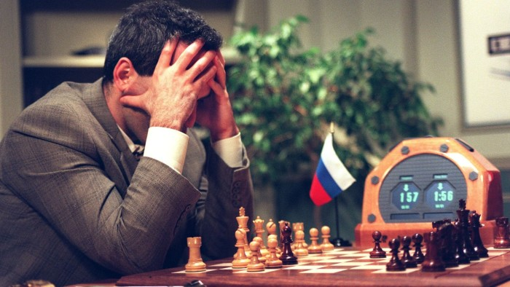
Deep Blue
World chess champion Garry Kasparov playing IBM's Deep Blue computer in 1997 © AFP

Slide 4


Slide 5
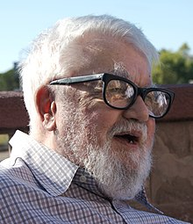
John McCarthy
Summer 1956

Slide 6
Artificial Intelligence
The study of Intelligent Agents:
Any device that
perceives its environment and
takes actions that maximise its chance of successfully achieving its goals.

Slide 7
Artificial Intelligence
Incorporating human intelligence to machines
Simulate natural intelligence to solve complex problems
Primarily used in decision making

Slide 8
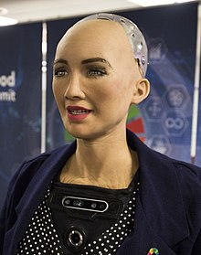
Sophia
Notes:
https://www.youtube.com/watch?v=W0_DPi0PmF0&ab_channel=CNBC

Slide 9
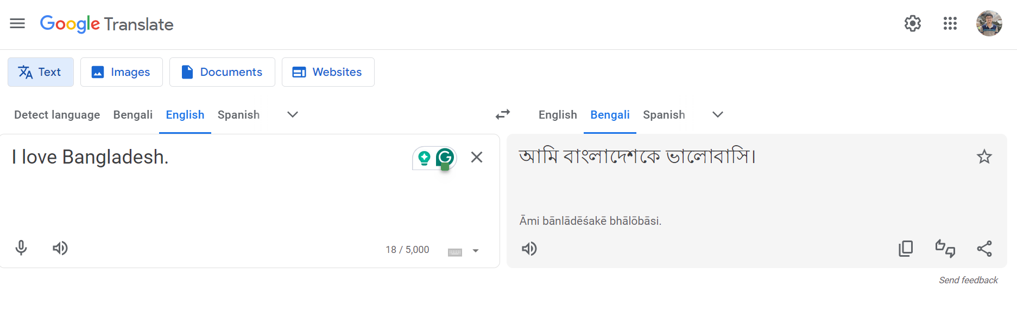
Google Translator

Slide 10
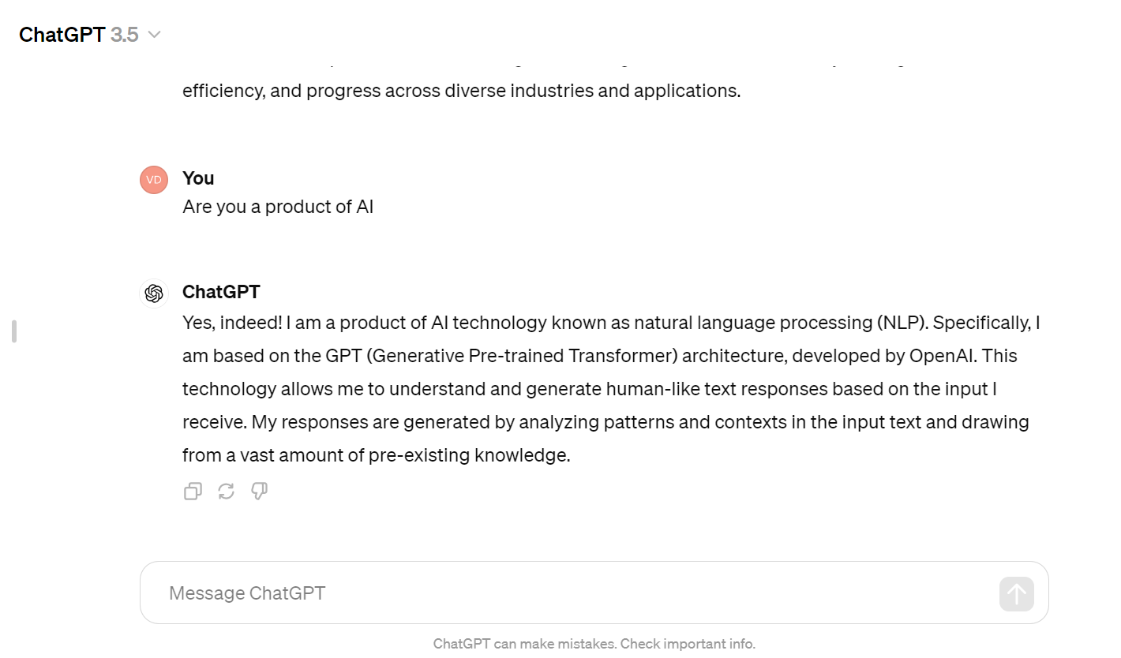
ChatGPT

Slide 11
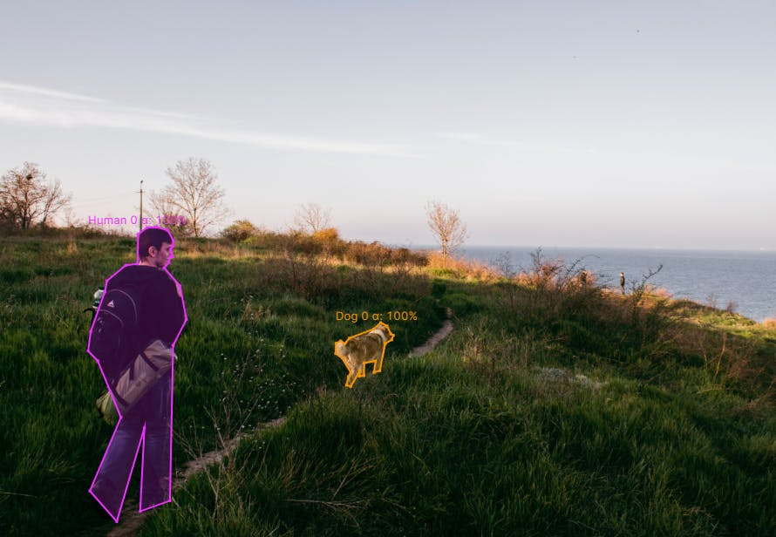
Image Segmentation

Slide 12

Relationship between Some Popular Terms
Image_source

Slide 13
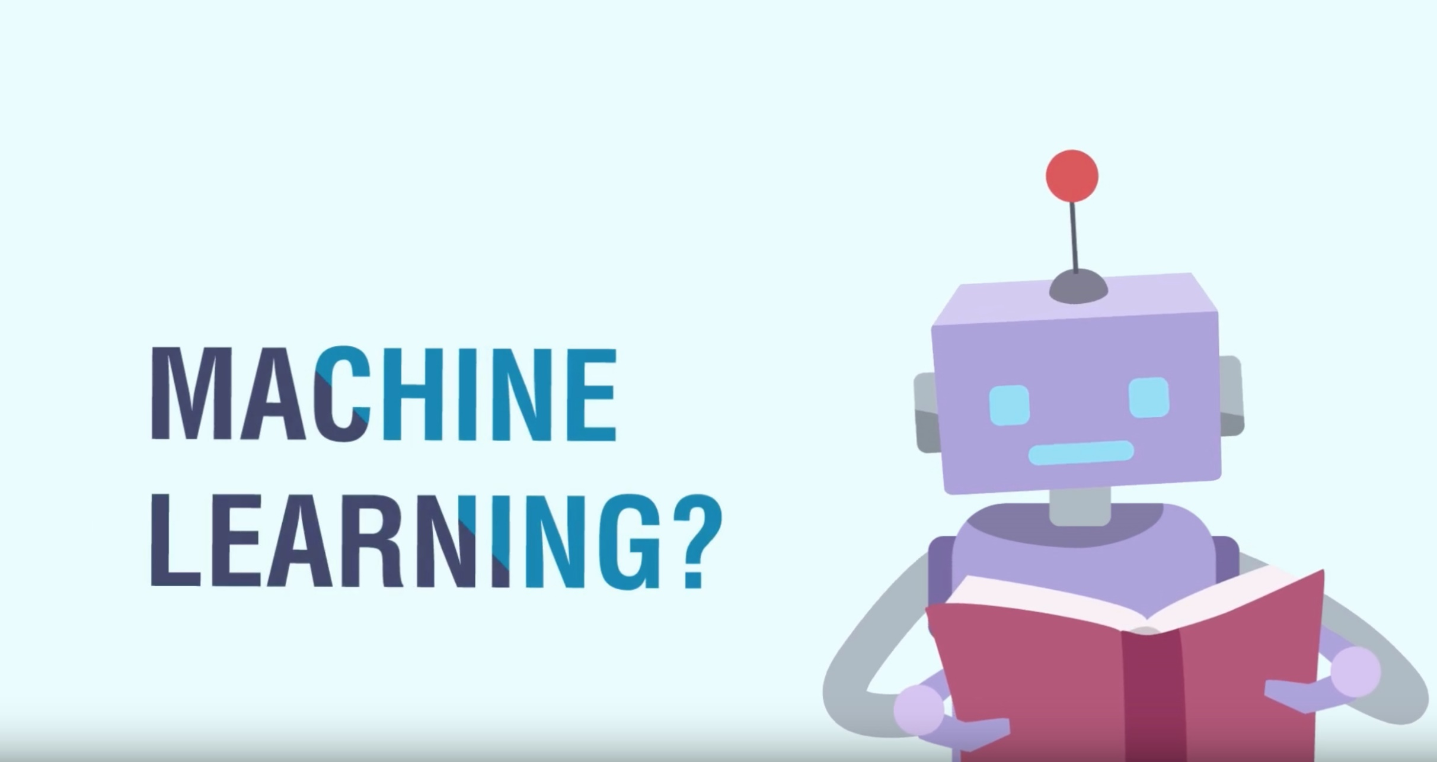

Slide 14
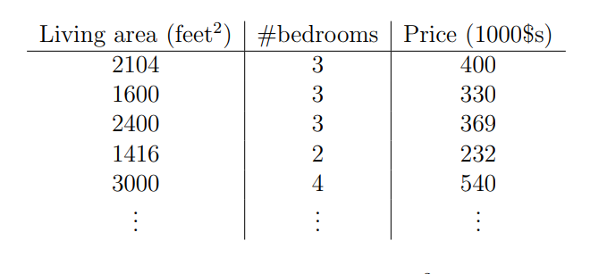
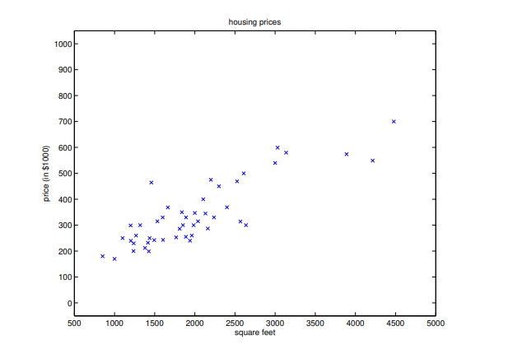
House Rent

Slide 15
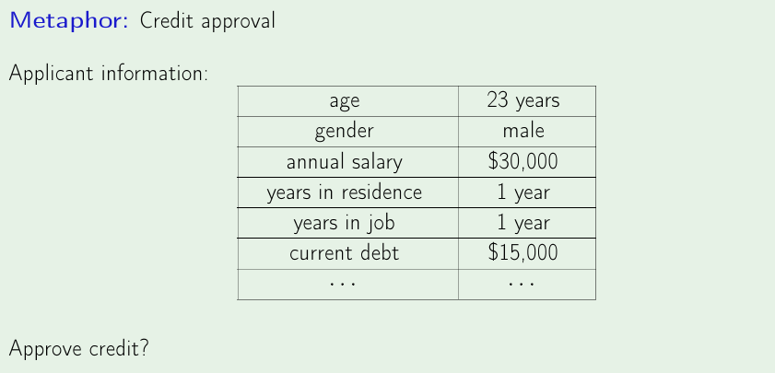
Bank Loan Approval

Slide 16
What Is Machine Learning
Wikipedia - Machine learning is a scientific
discipline that explores the construction and study of algorithms that can learn from data
Algorithms that can improve their performance using data

Slide 17
What We Will Do Using Machine Learning
Creating programs that can automatically learn rules/patterns from data

Slide 18
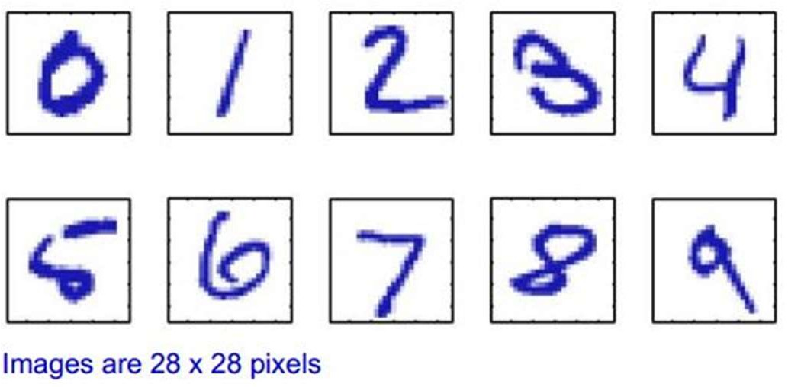
Example – Character Recognition(Classification)
Lets say we have 1000 worked-out examples
We can then train an algorithm with these examples, which can then recognize unseen examples

Slide 19


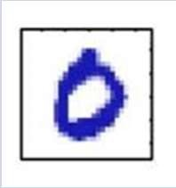
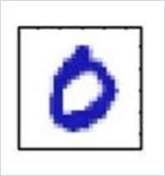
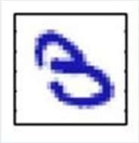
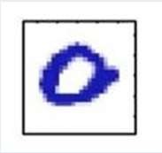

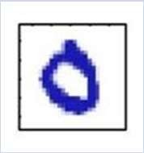
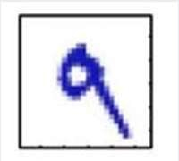
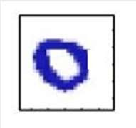
Training Examples (MNIST)
Image
Classification
Image
Classification
Zero
Zero
Three
Zero
Five
Zero
Nine
Zero

Slide 20


ZERO
Input / Unknown Example
Learning Algorithm
Training Examples

Slide 21
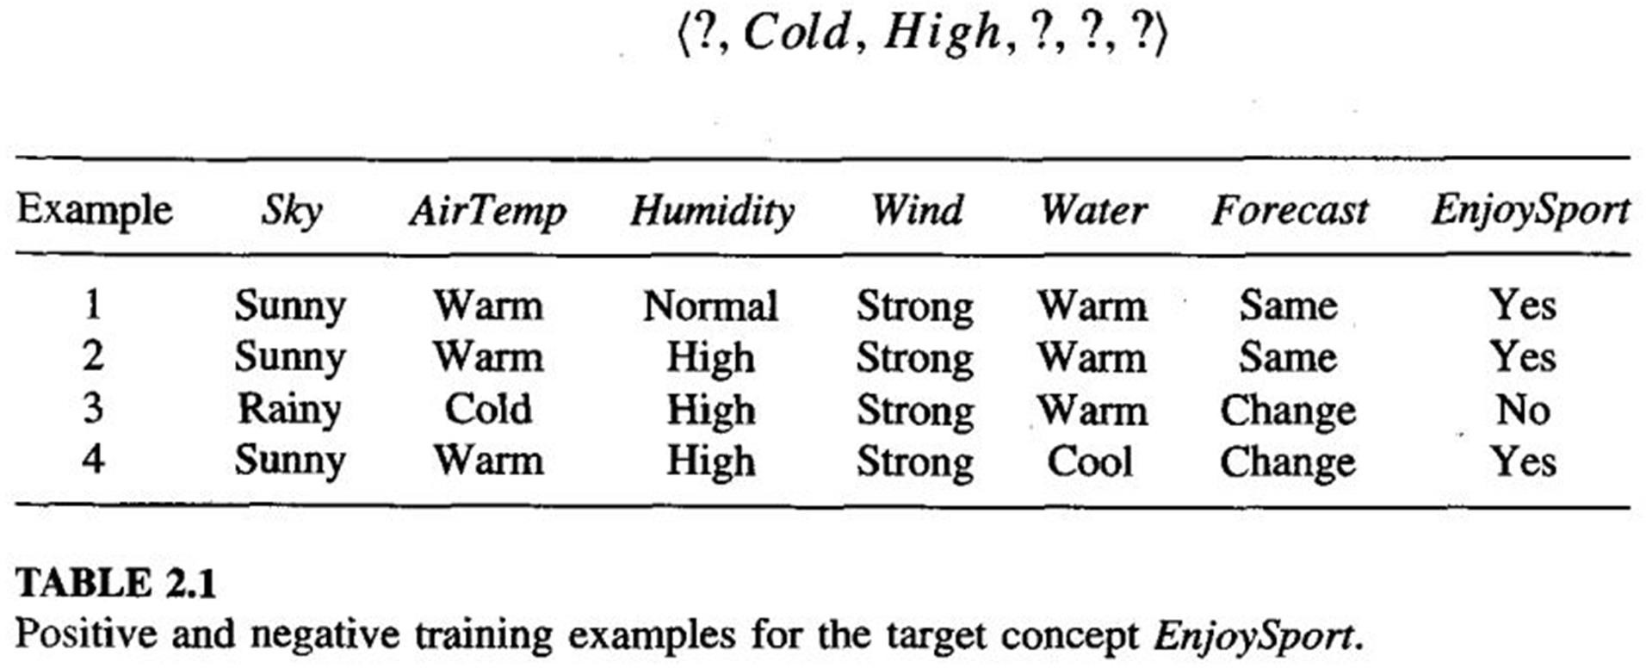
Enjoy Sports (Classification)

Slide 22

Function Approximation/Regression
We have information about Tamim Iqbal’s last 100 One Day innings
Weather Venue Pitch Day/Night … Run
Cold Mild Sunny
Mirpur Auckland Lords
Flat Green Dusty
Yes Yes No
…
…
…
15
54
83
…
…
…
…
…
…
What will be Tamim Iqbal’s score if?
– Weather – Mild, Pitch – Flat, Venue-Dhaka D/N- No

Slide 23
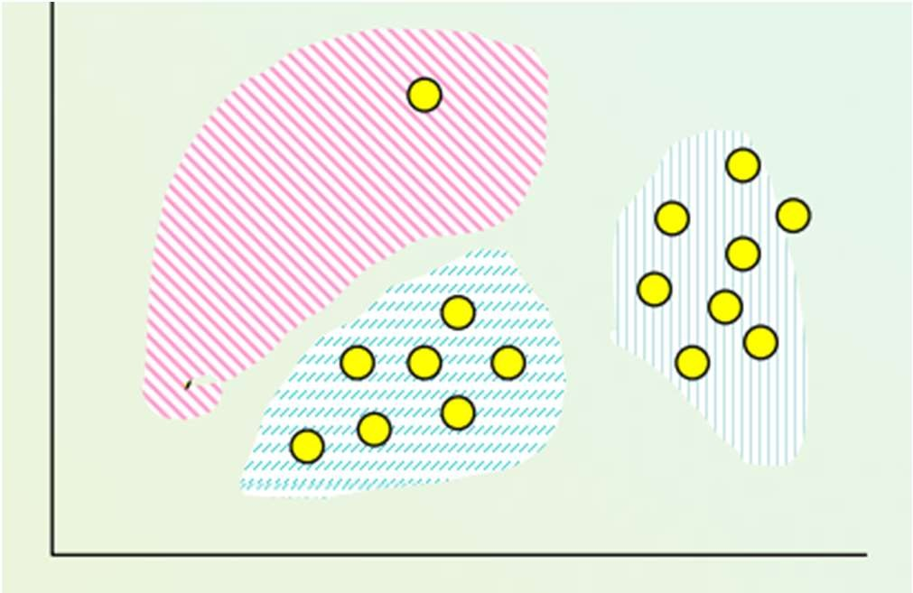
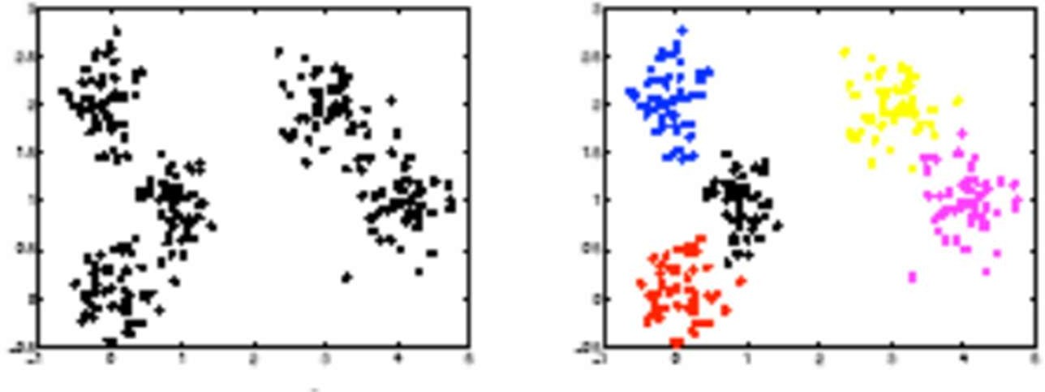
Clustering

Slide 24
Clustering
Find group of similar points
Help marketers discover distinct groups in their customer bases, and then use this knowledge to develop targeted marketing programs
Each customer may be represented by their salary, amount of products bought per month, living place, education, qualification, number of credit cards used, etc.

Slide 25
Learning
Learning can be classified as follows
Supervised Learning
Unsupervised Learning
Reinforcement Learning

Slide 26
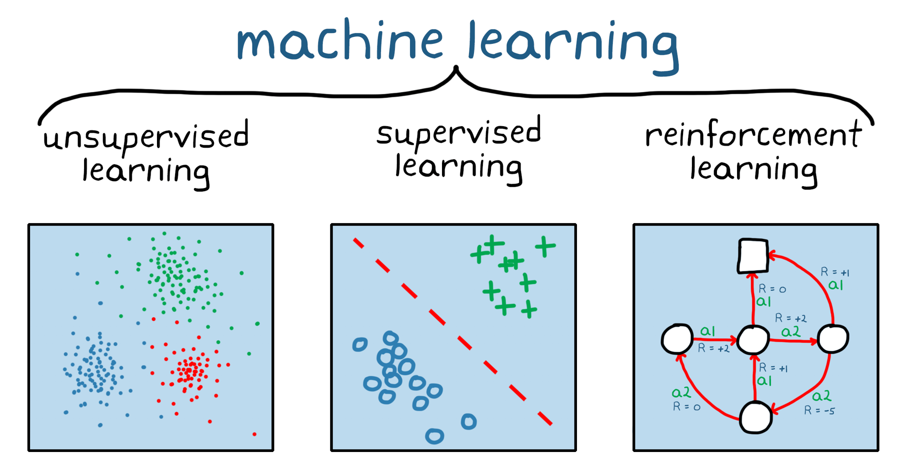
Learning

Slide 27
Supervised Learning
The agent observes some example input output pairs and learns a function that maps from input to output
Two basic types
Classification
Regression

Slide 28
Supervised Learning
Labeled Examples
Given input-output pairs as example
Learns a function/hypothesis that maps input to output
– Can be thought as there is a teacher/oracle who gives you “labeled examples”

Slide 29
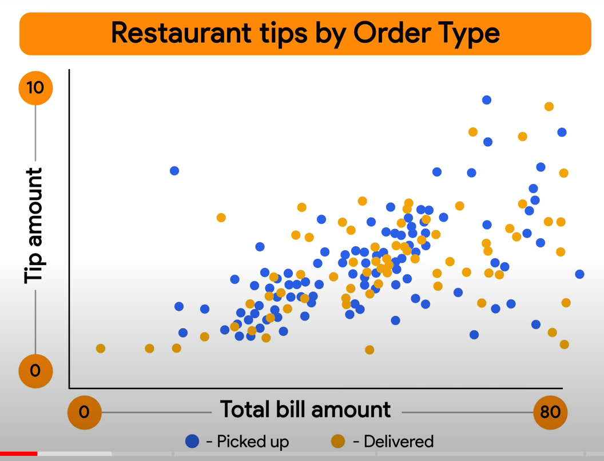
Supervised Learning

Slide 30
Find a problem that falls under supervised learning

Slide 31
Supervised Learning Scenarios
Face Recognition
Character Recognition
Document Classification
Sentiment Analysis
Disease Detection

Slide 32
Unsupervised Learning
The agent learns patterns in the input even though no explicit feedback is supplied.
The most common unsupervised learning task is clustering.

Slide 33
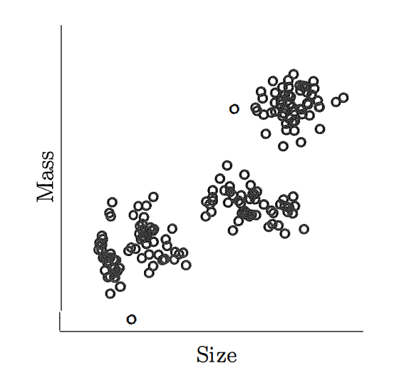
Unsupervised Learning

Slide 34
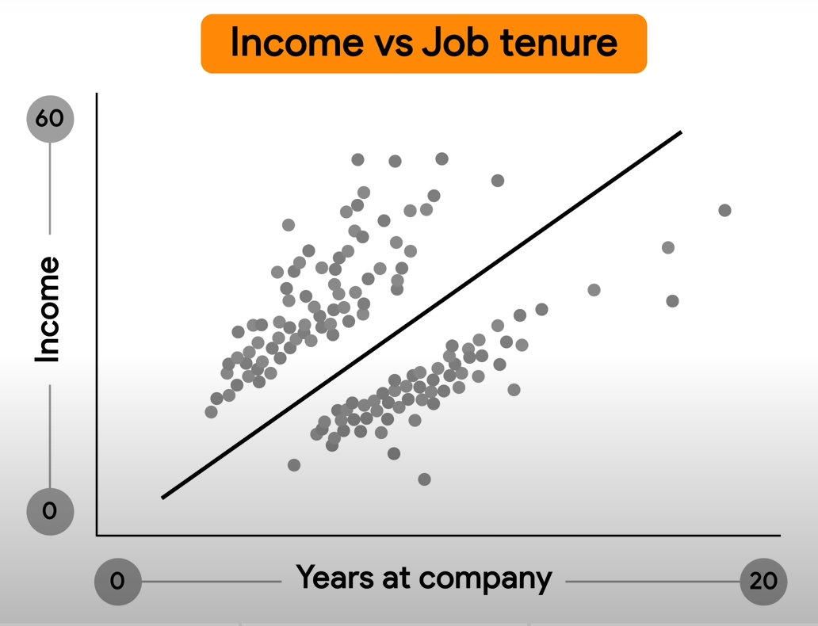
Unsupervised Learning

Slide 35
Reinforcement Learning
The agent learns from a series of reinforcements
– rewards or punishments

Slide 36
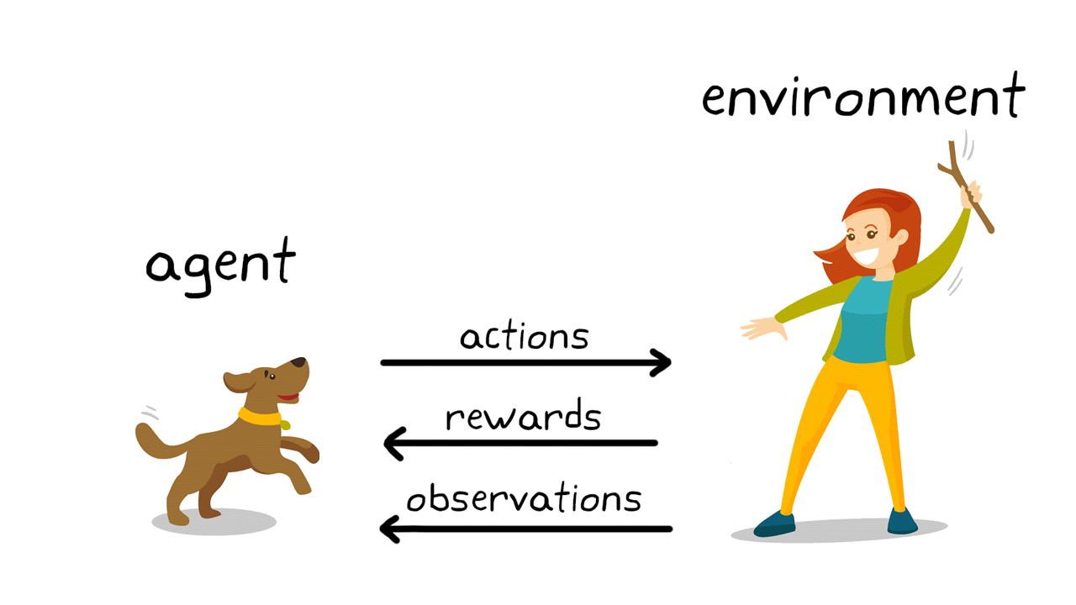
Reinforcement Learning
Notes:
image_source: https://www.mathworks.com/discovery/reinforcement-learning.html

Slide 37
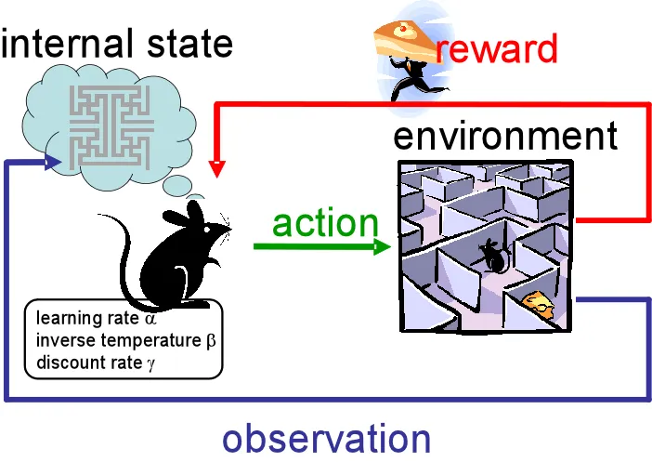
Reinforcement Learning
Notes:
image_source: https://www.mathworks.com/discovery/reinforcement-learning.html

Slide 38
Some Applications of Reinforcement Learning
Autonomous vehicle
Robotics
Artificial game agent (such as AlphaGo)

Slide 39
What is the difference between reinforcement learning and supervised learning ????

Slide 40
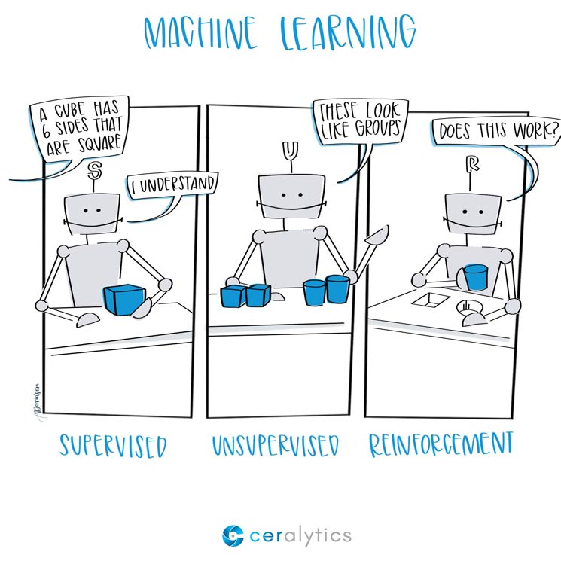
Three Main Types of Learning
The three main types arise based on the type of feedback that the agent gets from the environment.

Slide 41
The importance of feature vector
in case of supervised learning
The features should actually have effect on the classification.

Slide 42
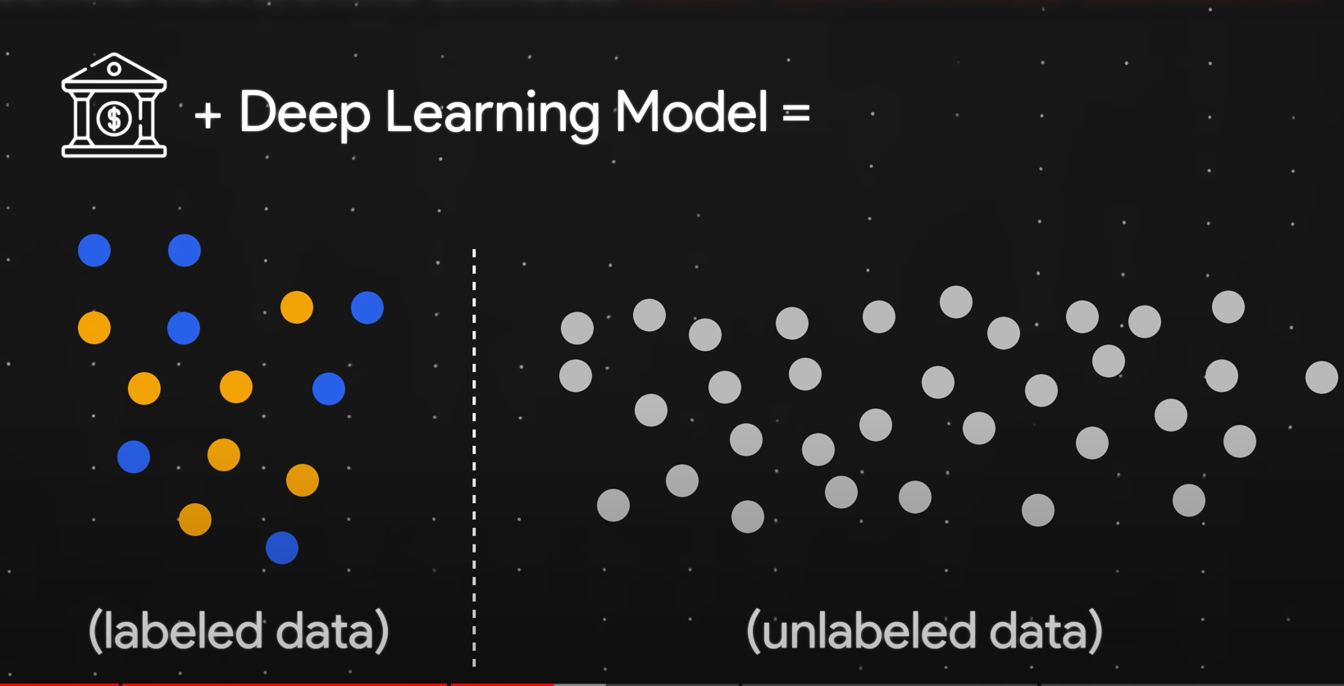
Semi-Supervised Learning
Uses a small amount of labeled data with a large amount of unlabeled data

Slide 43
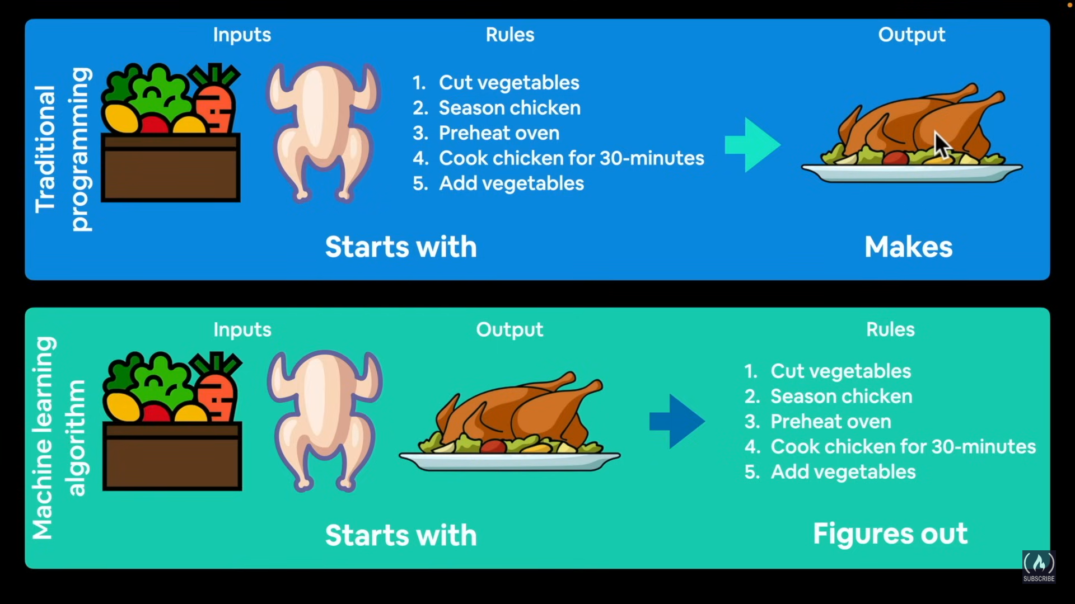
Traditional Algorithms vs Machine Learning Algorithms

Slide 44
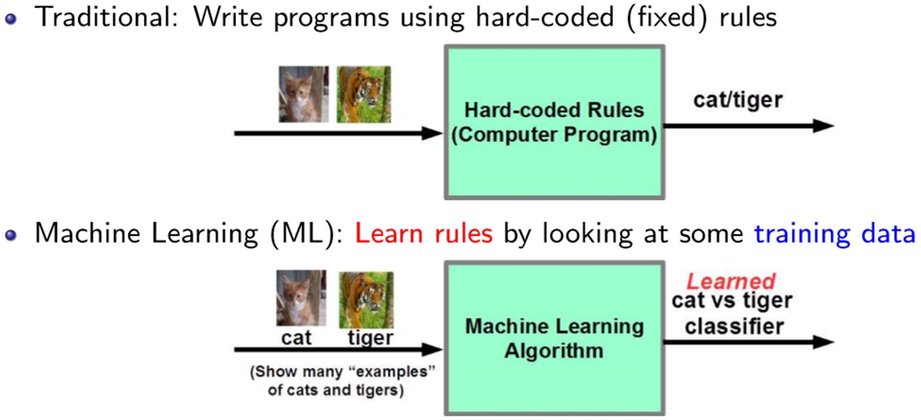
Traditional Algorithms vs Machine Learning Algorithms

Slide 45
Some real-world applications
Information retrieval (text, visual, and multimedia searches)
Machine Translation
Question Answering
Social networks
Recommender systems (Amazon, Netﬂix, etc.)

Slide 46
Some real-world applications
Speech/handwriting/object recognition
Ad placement on websites
Credit-card fraud detection
Weather prediction
Autonomous vehicles (self-driving cars)
Healthcare and life-sciences
... and many more applications in sciences and engineering

Slide 47
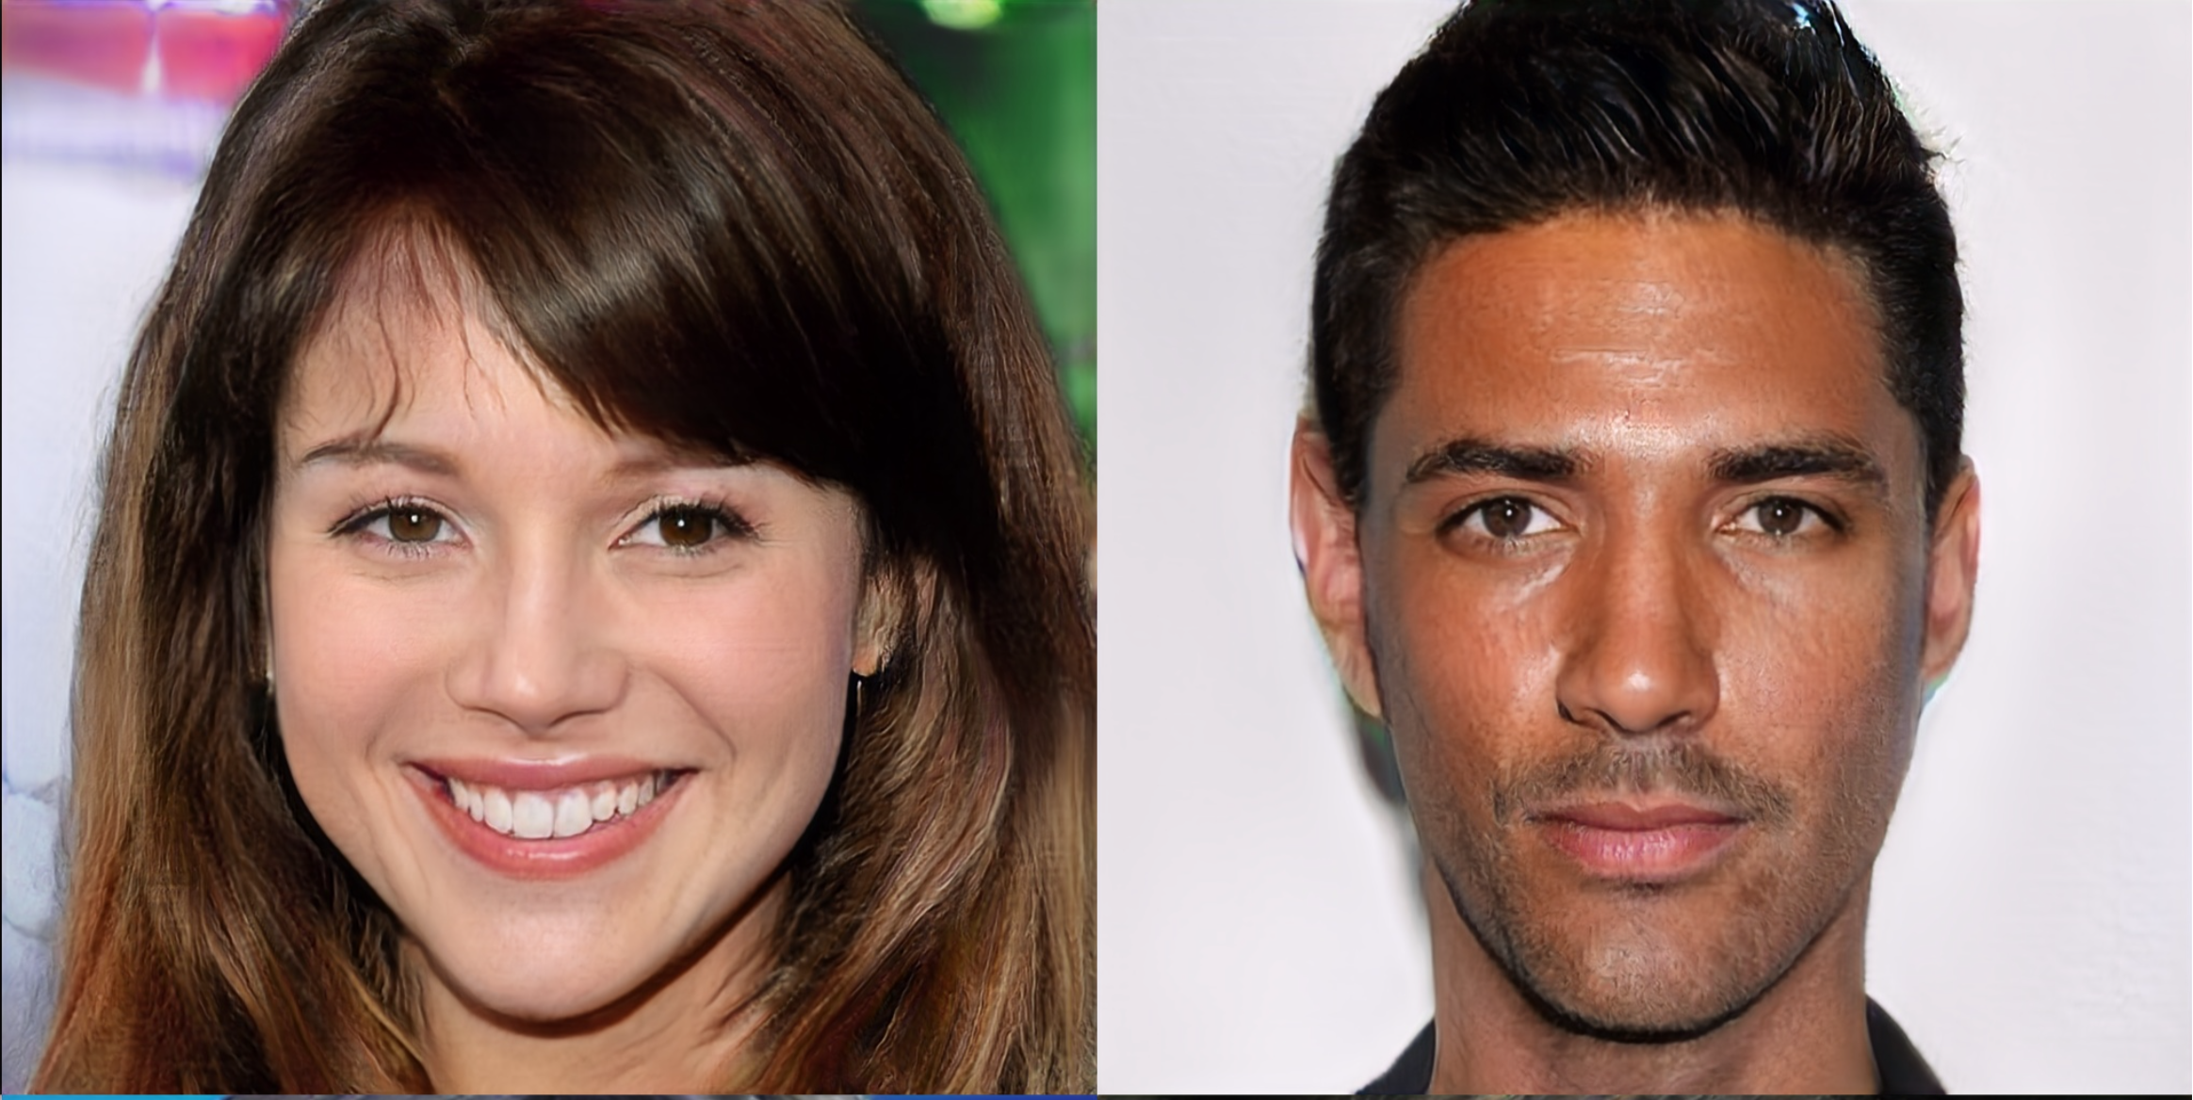
These are not real people!
Generated by ProGAN, developed by NVIDIA

Slide 48
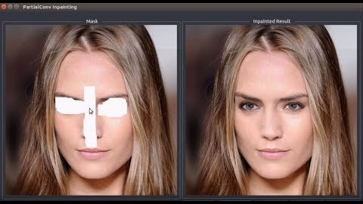
Filling up holes in photo

Slide 49
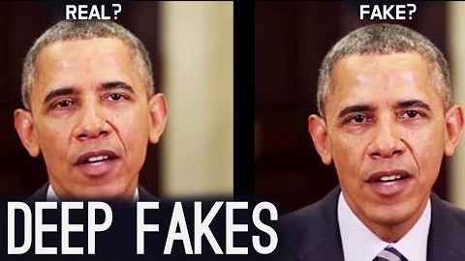
DeepFake

Slide 50
Data Sets
https://archive.ics.uci.edu/datasets
– Old : http://kdd.ics.uci.edu/

Slide 51
Resources
Google
Machile Learning by Tom Mitchell
https://towardsdatascience.com/progan-how-nvidia-generated-images-of-unprecedented-quality-51c98ec2cbd2
https://www.youtube.com/watch?v=dMF2i3A9Lzw
https://www.youtube.com/watch?v=147GawtmE8g
https://www.youtube.com/watch?v=gg0F5JjKmhA
https://towardsdatascience.com/applications-of-reinforcement-learning-in-real-world-1a94955bcd12
https://medium.com/@jrodthoughts/understanding-semi-supervised-learning-a6437c070c87
https://hackernoon.com/artificial-intelligence-vs-machine-learning-whats-the-difference-9e35u30a0

Slide 52
Any Questions

